Slide 1


CSCE 5610 Computer System Architecture
Exam Review

Slide 2
Outline
This is a review, not an in-depth coverage of every topic and concept we have gone over. Please review your notes, the slides and the assignments to make sure you are not missing anything for the exam.

Slide 3
Important
Failure to follow these rules may result in you receiving an undesirable grade on your exam plus other consequences
Calculator is needed.
No cell phones are permitted for any reason!
NO MAKEUP EXAM

Slide 4
Exam Format
The exam will cover all the content we discussed.
Specifically, we will test the content from Slides02 – Slides09
Exam I (November 7, 11:30am-12:30pm)
5 True/False, multi-choice and multi-answer questions
3 Calculation questions
3-4 Concept questions
Exam II (November 14, 11:30am-12:30pm)
5 True/False, multi-choice and multi-answer questions
3 Calculation questions
3-4 Concept questions

Slide 5
Slide 02
MIPS Assembly language
MIPS is a register-to-register, or load/store, architecture.
MIPS uses three-address instructions for data manipulation.
MIPS processors have 32 registers, each of which holds a 32-bit value.
MIPS memory is byte-addressable, which means that each memory address references an 8-bit quantity. Be careful, if A is an integer array, A[0] in address $s0, A[1] should be in address $s0+4.

Slide 6
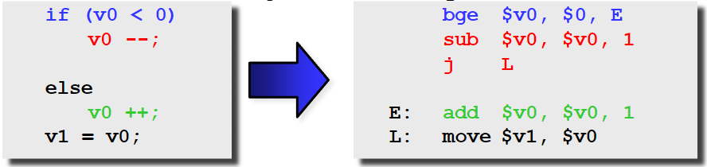
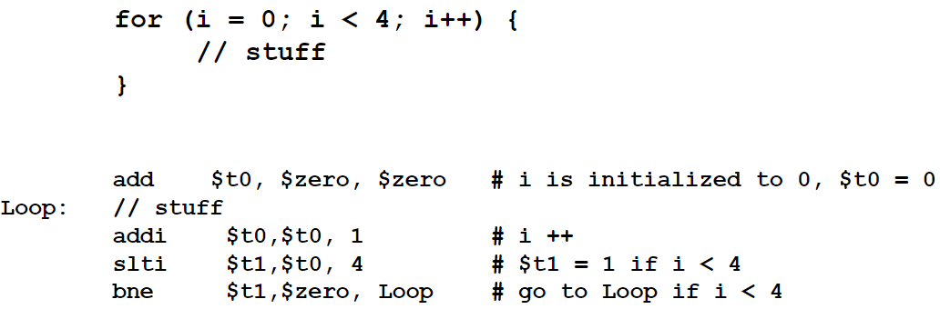
Slide 02
From high level code to MIPS Assembly language
Basic ALU operations
If-then-else:
Loop:

Slide 7



Slide 03
Three instruction format
R-type: add, sub, etc.
I-type: addi, lw, swq, beq, etc.
J-type: j, jr, etc.
Decode the Machine language
From Machine language to MIPS assembly code
Single cycle MIPS processor
Trace the dataflow of the instructions.

Slide 8

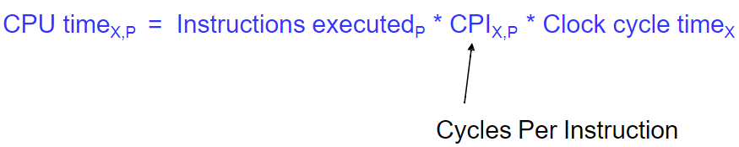
Slide 04
Single Cycle Performance
CPU Time.
Static instruction count vs. dynamic instruction count.
Determine the clock cycle time based on the given execution time of each instruction

Slide 9

Slide 05
Pipelining
Five pipeline stages.
Pipeline diagram
Pipelining performance
Insert NOP stages.
Pipeline performance
Determine the clock cycle time based on the given execution time of each stage

Slide 10
Slide 06
Hazards and pipeline bubbles
Structural hazards
result from not having enough hardware available to execute multiple instructions simultaneously
Data hazards (EXE/MEM, MEM/WB)
Hazards from R-type instructions can be avoided with forwarding.
Loads can result in a “true” hazard, which must stall the pipeline
Control hazards
arise when the CPU cannot determine which instruction to fetch next

Slide 11
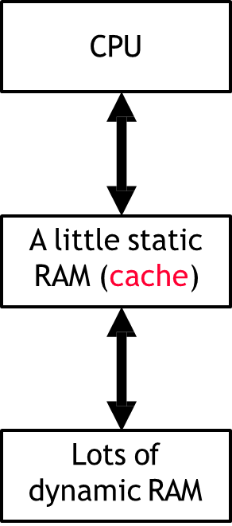
Slide 07
Cache
What is locality?
What is memory hierarchy, what are the levels of memory hierarchy?
What is cache? Types of cache? Direct mapped, set associative…

Slide 12
Slide 07
Cache
What is cache? Types of cache? Direct mapped, set associative…
Performance metric: average access time
AMAT = T_{hit} + %miss * T_{miss}
Memory and overall performance:

Slide 13
Slide 08-09
Virtual Memory
Virtual Address
Physical Address
From virtual address to physical address

